Slide 1
Database
Introduction | Types | Relational Database Model | SSMS | Data Types| Data Retrieval | Data Filtering | Joins | Schema Creation |Data Modification | Normalization

Slide 2

Introduction
Database:
A structured Collection of Information
Easily Accessible, manageable, Updateable
Fast Retrieval and Reliable
Types:
Relational Databases
Store data in tables (relations) composed of rows and columns.
Examples: Microsoft SQL Server, MySQL, PostgreSQL, Oracle
Non-Relational (NoSQL) Databases
Store data in formats other than tabular relations—such as key-value pairs, documents, wide-column stores, or graphs.
Examples: MongoDB (document), Redis (key-value), Cassandra (wide-column), Neo4j (graph)

Slide 3
Relational Database Model
A set of relations (tables), each of which consists of:
Rows (tuples): individual records
Columns (attributes): fields that define the type of data stored
Some Components:
Schema: defines each table’s structure: column names, data types, and constraints.
Key: an attribute or a set of attributes in a table that helps uniquely identify rows (tuples) and establish relationships between tables.
Types: Super, Primary, Foreign, Composite, Candidate etc
Relationships: defines how are tables connected to each other
One to One: Each Student is associated with 1 and only 1 guardian.
One to Many: Each Department can have multiple Students
Many to Many: Many Students can enroll many Courses (Linking table)
Self- referencing : In a multi hierarchy company, manager can be referenced by the same employee id

Slide 4
Relational Database Model
Some Components:
Constraints: Rules applied to columns and tables to limit data manipulation (update, insert, delete)
Examples: NOT NULL, UNIQUE, PRIMARY KEY(), FOREIGN KEY(), CHECK(), DEFAULT

Slide 5
Data Types
Numeric:
INT, BITINT, SMALLINT, DECIMAL, NUMERIC, MONEY… etc
String
CHAR, VARCHAR, TEXT, NCHAR … etc
Date and Time
DATE, TIME, DATETIME
Binary
BINARY, VARBINARY, IMAGE

Slide 6
Data retrieval,Filtering and Joins
Clauses: define specific conditions within an SQL statement to retrieve, update, or manipulate data from a database.
Clause | Use
WHERE | Filters records based on a condition
ORDER BY | Sort results
GROUP BY | Groups results based on a column
HAVING | Filter grouped records based on condition
LIMIT | Restricts number of rows to certain records
FROM | Specifies the table from which to get results
LIKE | Used for pattern matching
TOP | Similar to LIMIT, used to restrict number of rows
AND | Combine multiple conditions with AND logic
OR | Combine multiple conditions with OR logic

Slide 7
Data retrieval, Filtering and Joins
SELECT Statement: used to fetch or retrieve data from a database
Combines with clauses to get results as per need.
Example: SELECT * FROM PATIENTS
Order of writing Clauses:
SELECT
FROM
WHERE
GROUP BY
HAVING
UNION
ORDER BY

Slide 8
Data retrieval, Filtering and Joins
Order of writing Clauses:
Example:
SELECT column1, COUNT(*)
FROM table_name
WHERE condition
GROUP BY column1
HAVING COUNT(*) > 1
ORDER BY column1
LIMIT 10;

Slide 9
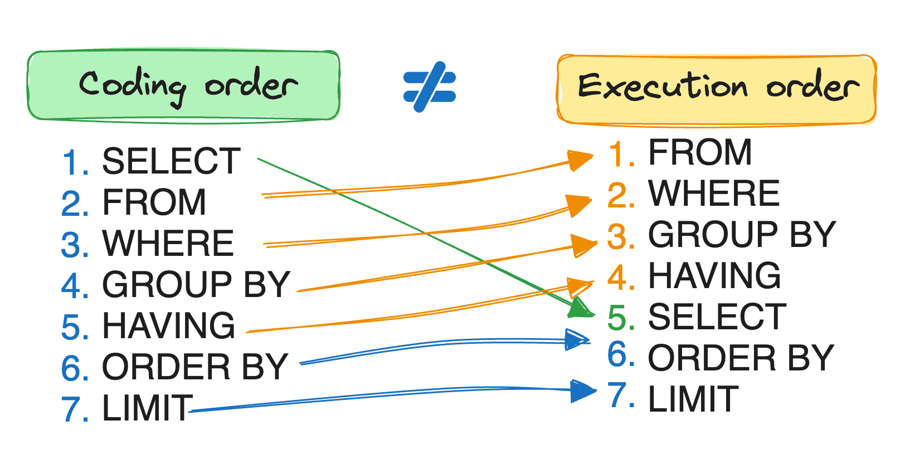
Data retrieval, Filtering and Joins

Slide 10
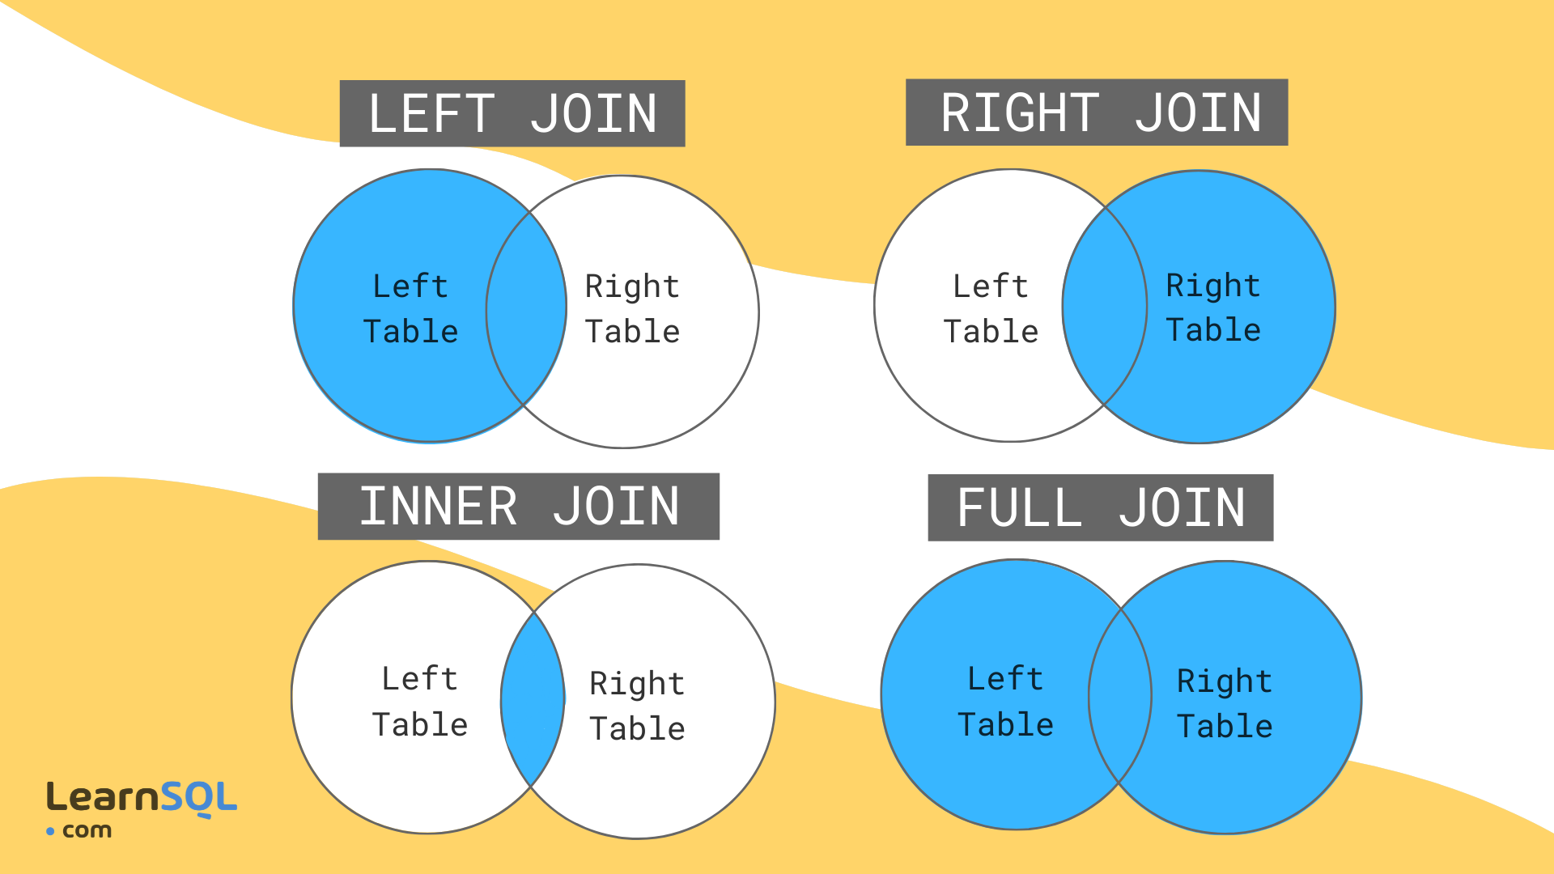
Data retrieval, Filtering and Joins
Joins: combining data from multiple tables
Types:
INNER JOIN: Gets common from both tables.
LEFT JOIN: All from the left and matching from the right
RIGHT JOIN: All from the right and matching from the left
FULL JOIN: All from both, non matching will have NULL

Slide 11
Schema Creation and Data modification
CREATE/ALTER/DROP:
Creating tables/ databases, changing column names, deleting tables etc
INSERT/UPDATE/DELETE
Inserting Data row, changing data in a row and deleting a row etc

Slide 12
Normalization
A process of organizing data so that no redundancy occurs
Forms: There are many types of Normal forms such as:
First Normal Form (1NF)
Second Normal Form (2NF)
Thirds Normal Form (3NF)
Boyce-Codd Normal Form (BCNF)
Mostly companies use normalization up to 3NF
When a schema follows rules of a normal form it is said that the schema satisfies that normal form

Slide 13
Normalization Rules
1NF
Every table cell must hold exactly one atomic (indivisible) value.
Each Record must be unique.
2NF
Must be in 1NF
No Partial Dependencies: If the primary key is composite (multiple columns), no non-key attribute may depend on only part of that key.
3NF
Must be in 2NF
No Transitive Dependencies: No non-key attribute may depend on another non-key attribute.

